Slide 1
Introduction to Deep Learning
Poo Kuan Hoong

Slide 2

Introduction
Artificial Intelligence (AI) is the subject of intense media hype.
Recent advances such as Self Driving Cars, AlphaGo, Chatbots, Facial Recognitions and many more.
Many large corporations are embracing AI as the core products
AI is labelled as the greatest invention in the last century that may change human civilization

Slide 3
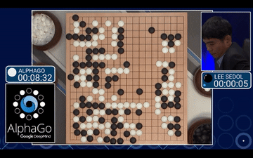
AlphaGo

Slide 4
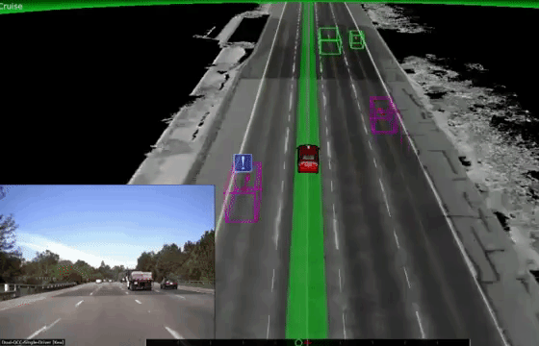
Self Driving Car

Slide 5




Slide 6

AI in Medical

Slide 7

The end is near?

Slide 8
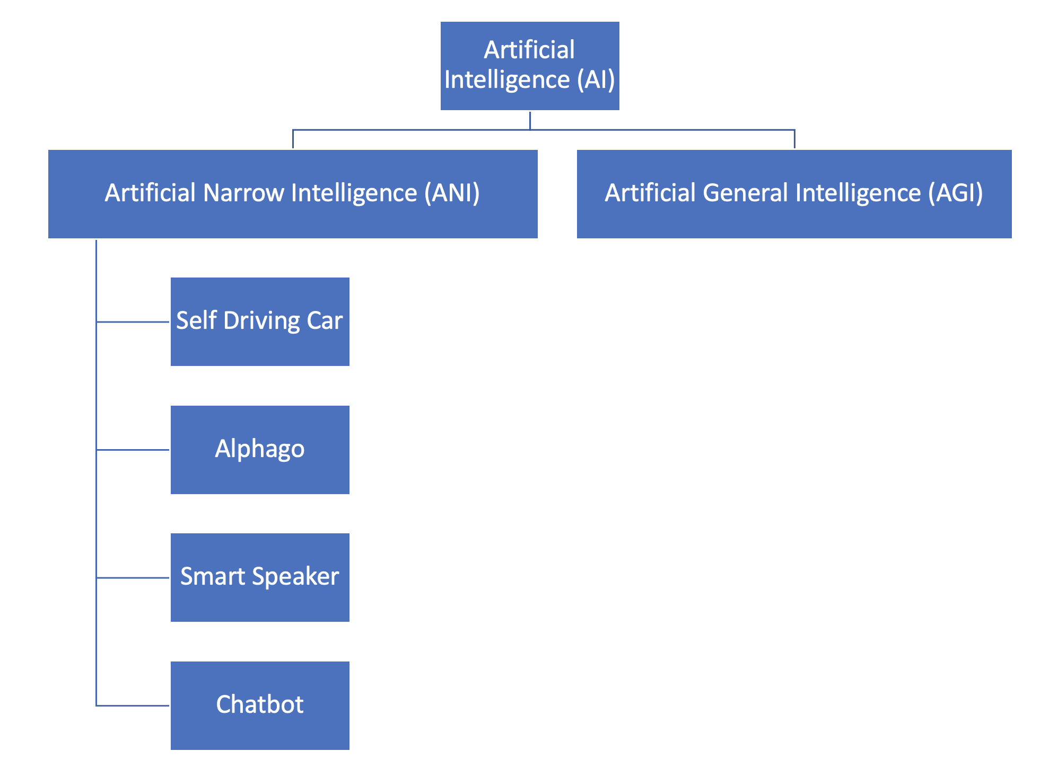

Slide 9


Slide 10
Classical Programming vs Machine Learning
Rules
Classical Programming
Answers
Data
Answers
Machine Learning
Rules
Data

Slide 11
Deep Learning
Deep learning is a specific subfield of machine learning: a new take on learning representations from data that puts an emphasis on learning successive layers of increasingly meaningful representations.
The word “Deep” refers to how many layers contribute to a model of the data which is also called the depth of the model.
Modern deep learning often involves tens or even hundreds of successive layers of representations and they’re all learned automatically from exposure to training data.

Slide 12

Neural Networks

Slide 13
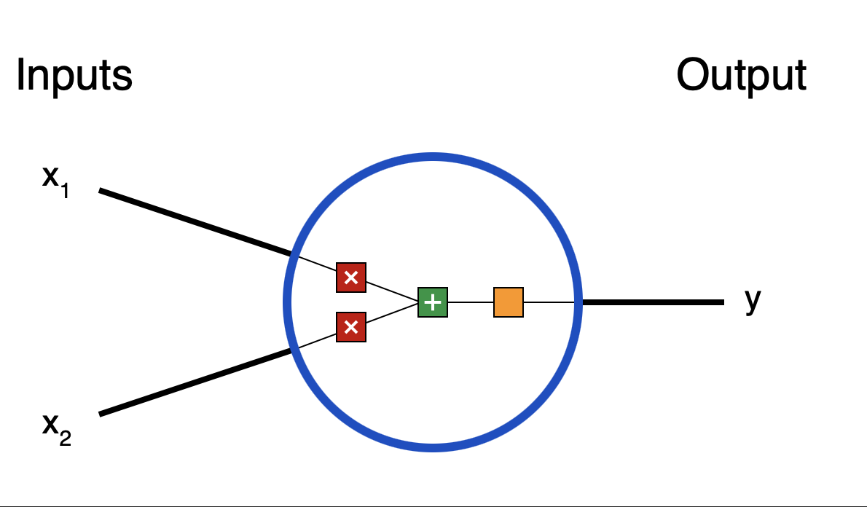
Weights and Biases
A neuron takes inputs, does some math with them, and produces one output. Here’s what a 2-input neuron looks like:

Slide 14
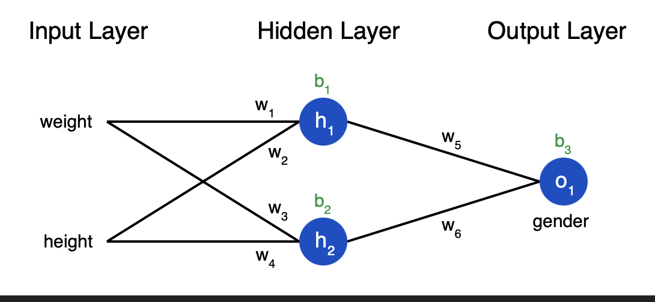

Slide 15
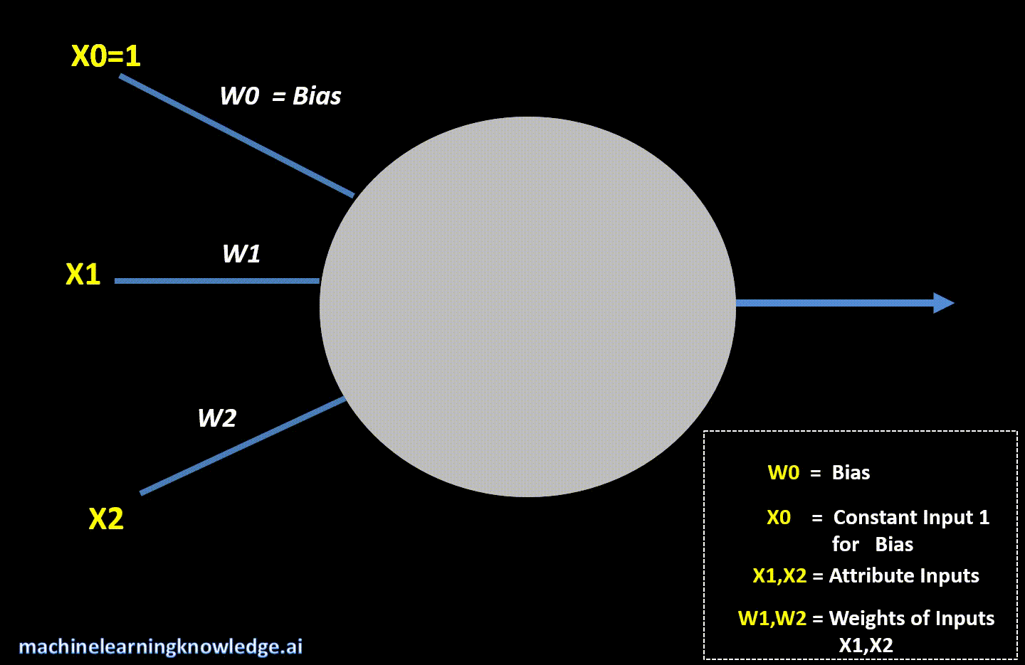

Slide 16
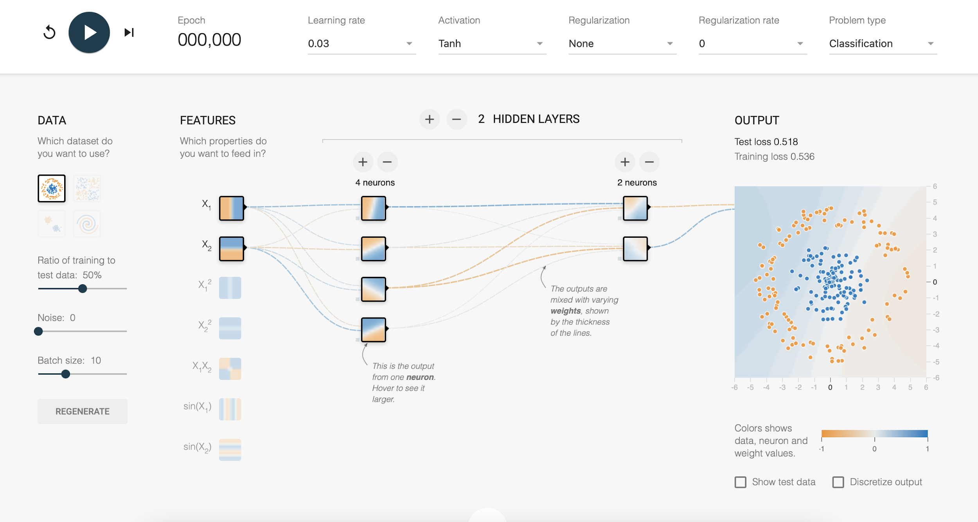
https://playground.tensorflow.org/

Slide 17
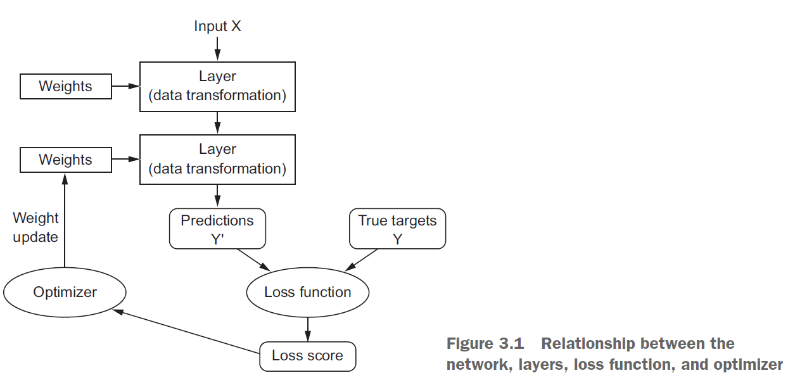
Overview

Slide 18
Initialization
The first step that comes in consideration while building a neural network is the initialization of parameters
if done correctly then optimization will be achieved in the least time otherwise converging to a minima using gradient descent will be impossible.
Techniques generally practised to initialize parameters :
Zero initialization
Random initialization

Slide 19

Forward Propagation
The input X provides the initial information that then propagates to the hidden units at each layer and finally produce the output, predicted y ( ).
The architecture of the network entails determining its depth, width, and activation functions used on each layer.
Depth is the number of hidden layers.
Width is the number of units (nodes) on each hidden layer since we don’t control neither input layer nor output layer dimensions.

Slide 20
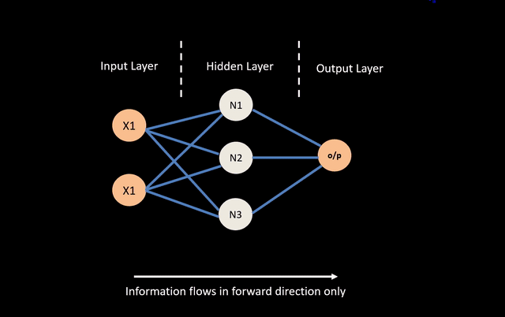

Slide 21
Backpropagation
Backpropagation (backward propagation) is an important mathematical tool for improving the accuracy of predictions in data mining and machine learning.
Essentially, backpropagation is an algorithm used to calculate derivatives quickly.
Artificial neural networks use backpropagation as a learning algorithm to compute a gradient descent with respect to weights.
Desired outputs are compared to achieved system outputs, and then the systems are tuned by adjusting connection weights to narrow the difference between the two as much as possible.

Slide 22


Slide 23
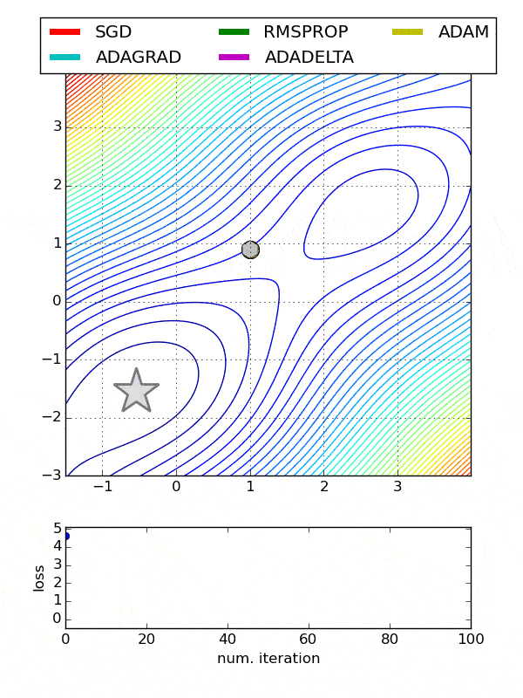
Optimizer
Optimizers are algorithms or methods used to change the attributes of your neural network such as weights and learning rate in order to reduce the losses.
There are various optimizers:
Gradient Descent
Stochastic Gradient Descent (SGD)
Mini-Batch Gradient Descent
Momentum
Adagrad
AdaDelta
Adam (Adaptive Moment Estimation)

Slide 24
Gradient Descent
Gradient descent is an optimization algorithm that's used when training a machine learning model. It's based on a convex function and tweaks its parameters iteratively to minimize a given function to its local minimum.
How big the steps are gradient descent takes into the direction of the local minimum are determined by the learning rate.
For gradient descent to reach the local minimum we must set the learning rate to an appropriate value, which is neither too low nor too high.

Slide 25

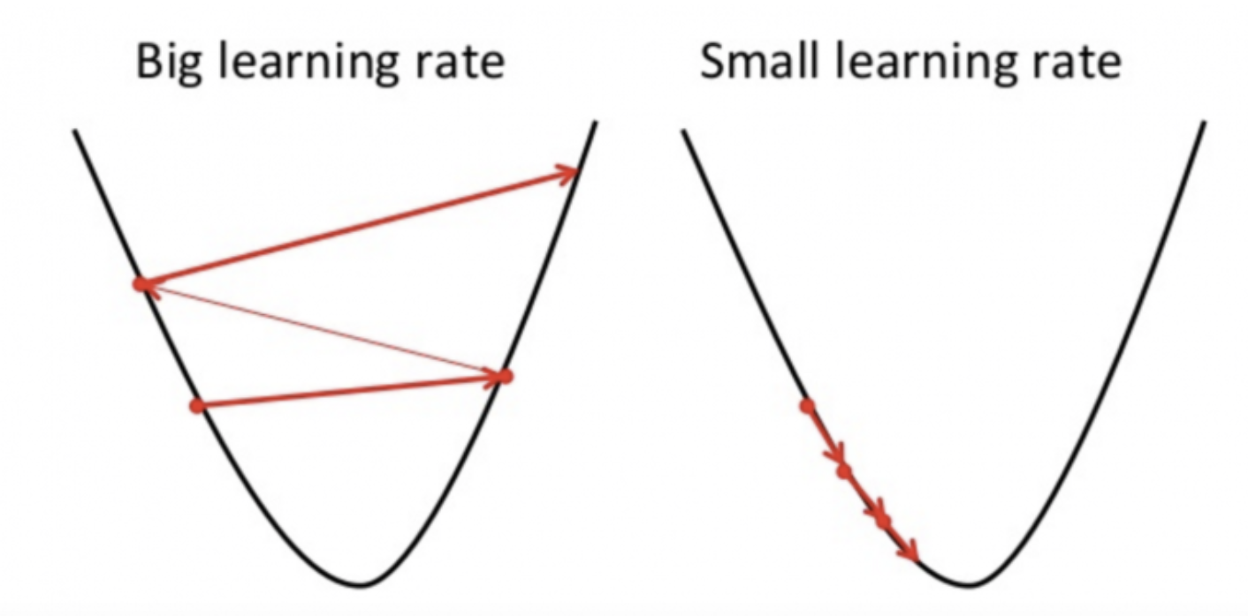
Gradient Descent

Slide 26


Slide 27
Activation Functions
Activation functions determine the output of a deep learning model, its accuracy, and also the computational efficiency of training a model.
Activation functions also have a major effect on the neural network’s ability to converge and the convergence speed, or in some cases,
The function is attached to each neuron in the network, and determines whether it should be activated (“fired”) or not, based on whether each neuron’s input is relevant for the model’s prediction.
Common activation functions:
Sigmoid
Linear
ReLu
Tanh

Slide 28
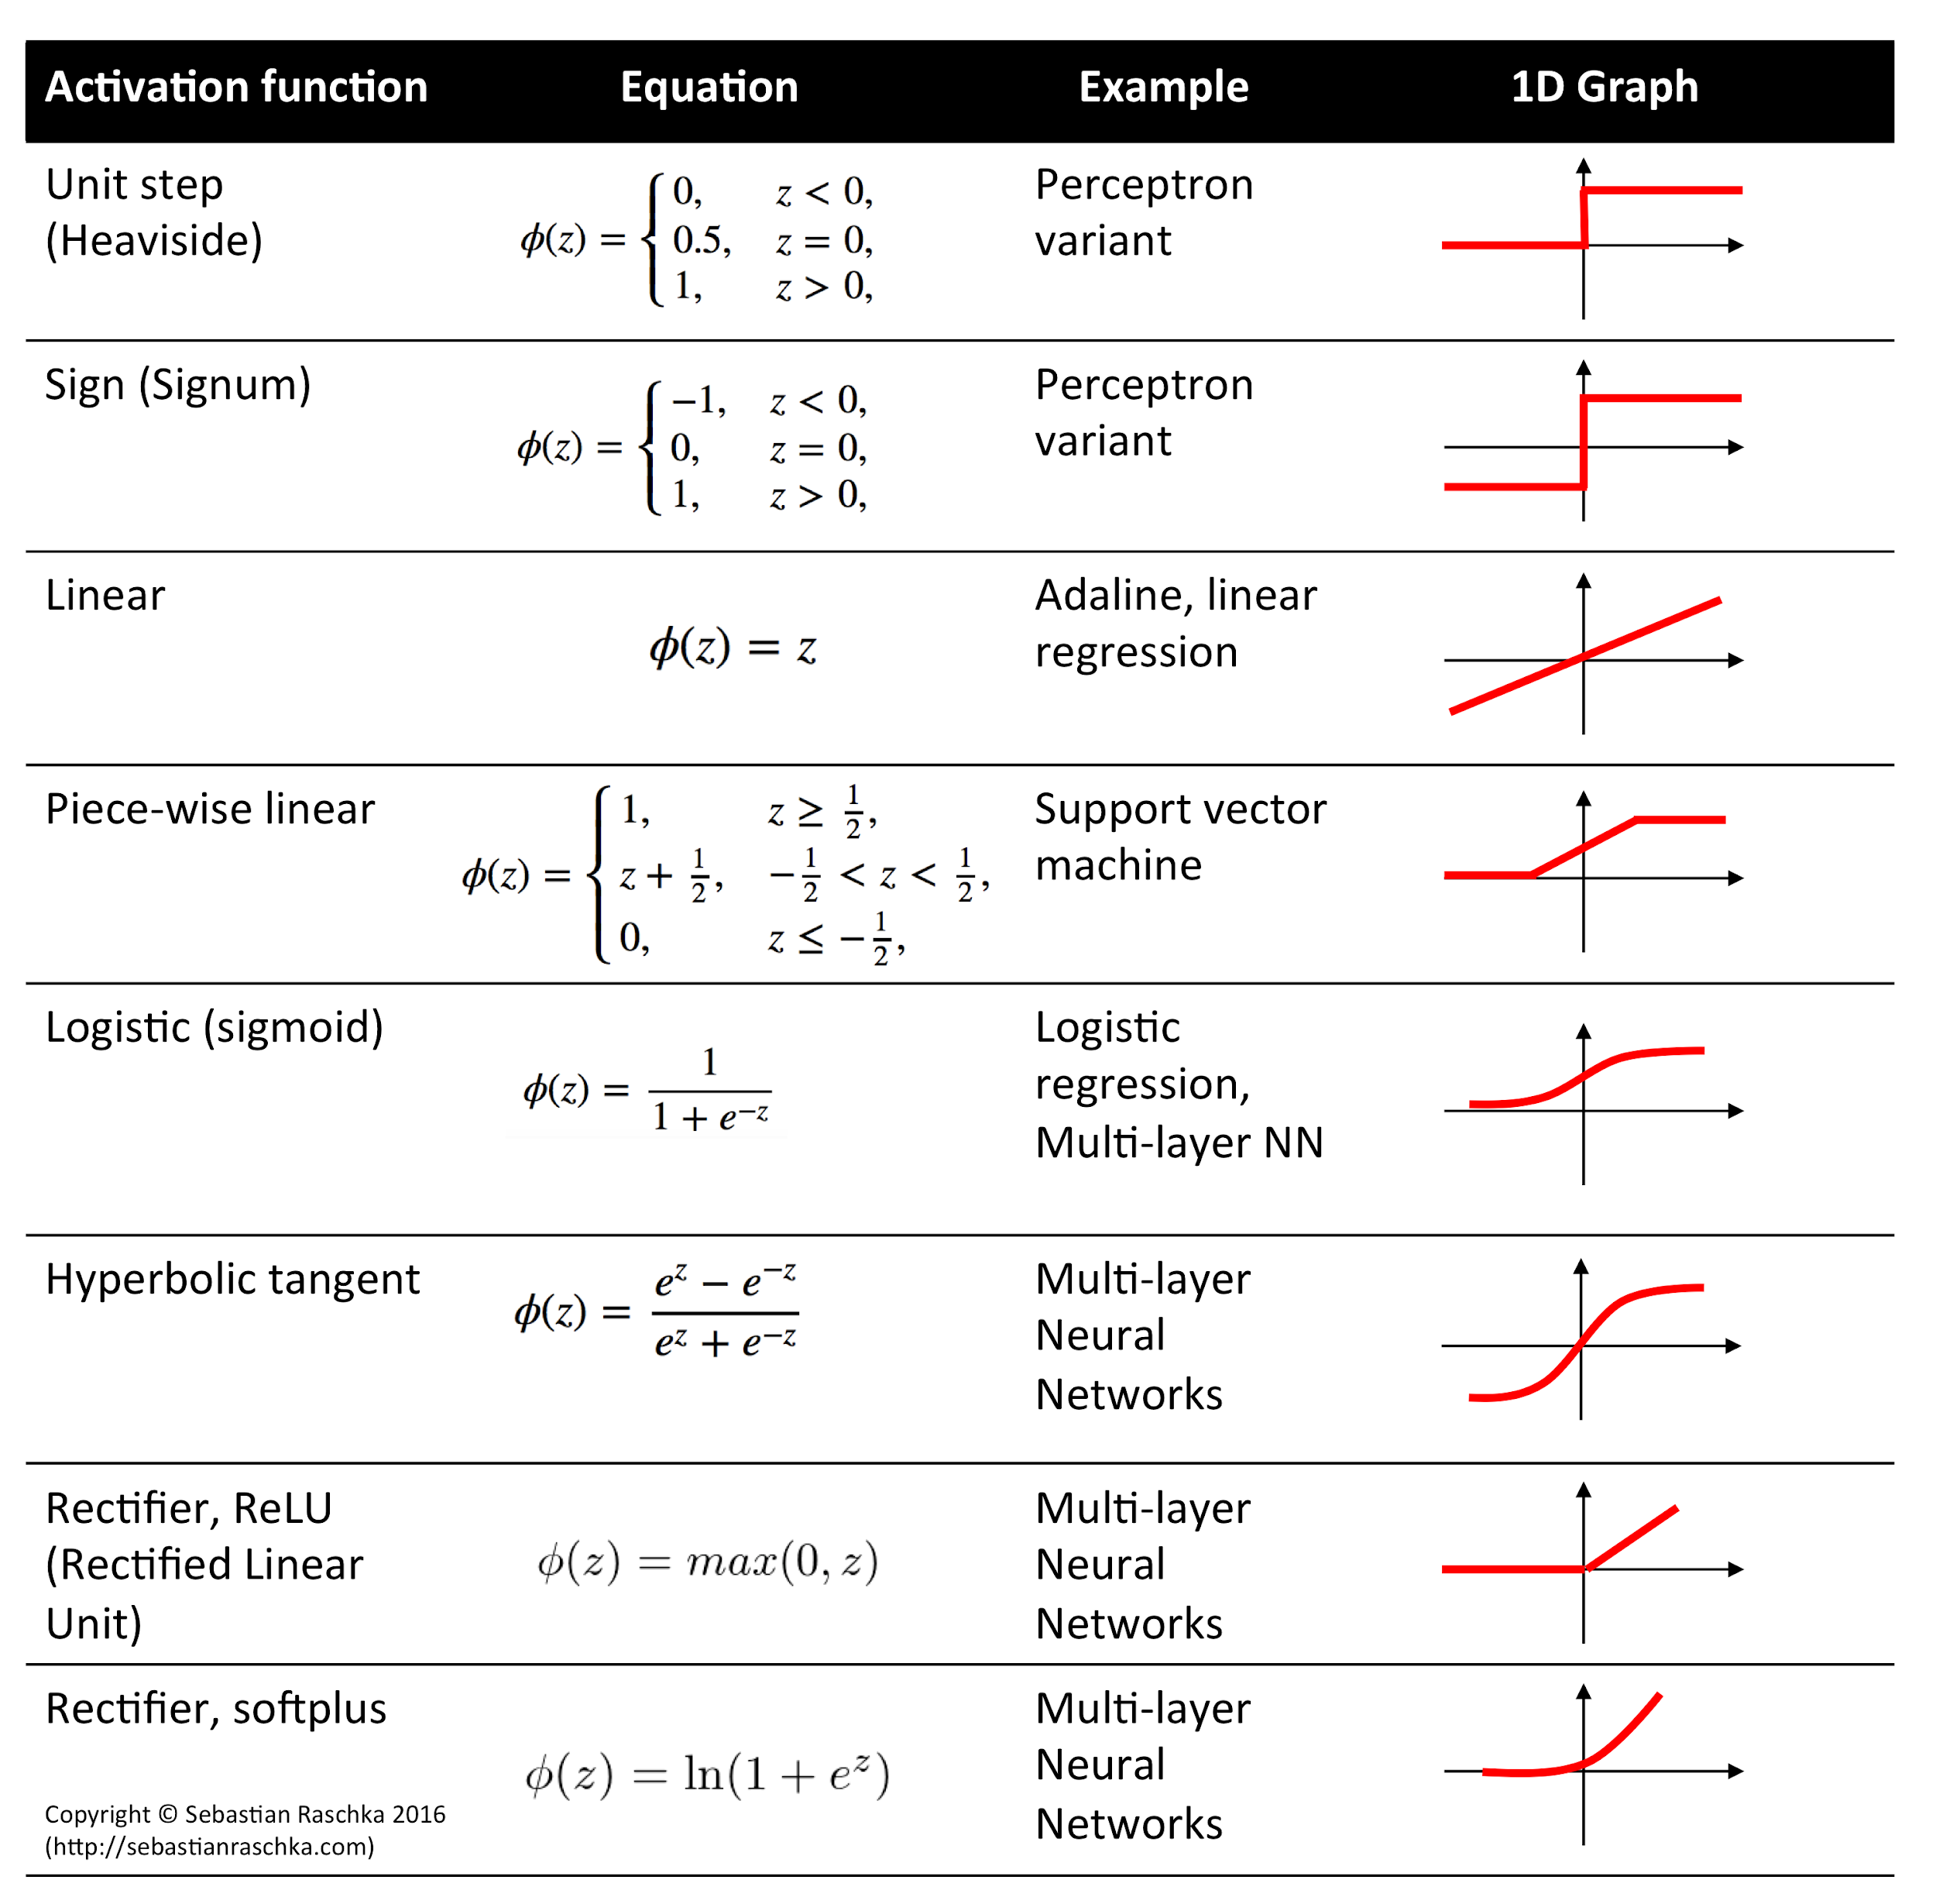

Slide 29
Loss Function
Prior training the neural networks, you are required to choose a loss function when designing and configuring your model.
The gradient descent algorithm seeks to change the weights so that the next evaluation reduces the error, meaning the optimization algorithm is navigating down the gradient (or slope) of error.
In the context of an optimization algorithm, the function used to evaluate a candidate solution (i.e. a set of weights) is referred to as the objective function.
For regression:
Mean Square Error (MSE) or Mean Absolute Error (MAE)
For Binary Classification:
Binary Cross Entropy Loss
For Multiclass classification:
Multi-Class Cross-Entropy Loss

Slide 30
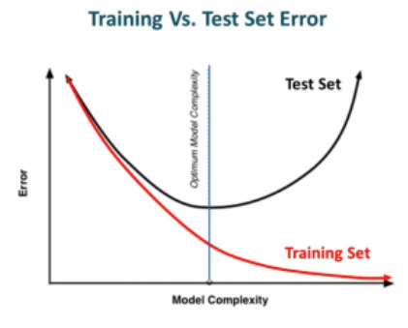
Regularisation
Complex neural networks with many layers tend to be overfitting
Regularization is a technique which makes slight modifications to the learning algorithm such that the model generalizes better. This in turn improves the model’s performance on the unseen data as well.
Common regularisation techniques:
L₁ and L₂
Dropout
Data Augmentation
Early Stopping

Slide 31
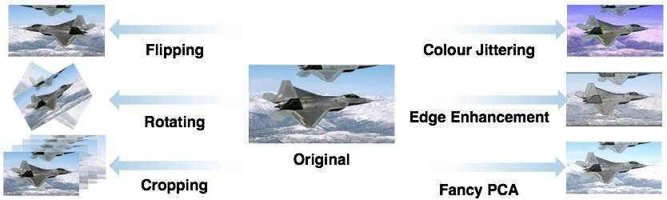
Data Augmentation
Data augmentation is a strategy that enables practitioners to significantly increase the diversity of data available for training models, without actually collecting new data.
Data augmentation techniques such as cropping, padding, and horizontal flipping are commonly used to train large neural networks.

Slide 32
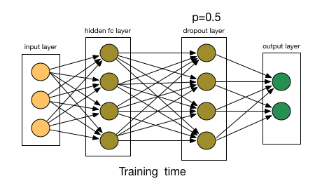
Dropout
Dropout is a common regularisation technique
At every iteration, it randomly selects some nodes and removes them along with all of their incoming and outgoing connections.
This probability of choosing how many nodes should be dropped is the hyperparameter of the dropout function.

Slide 33
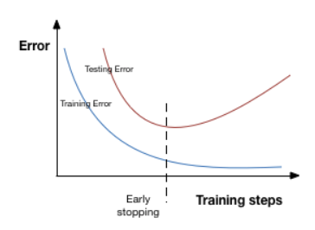
Early Stopping
Early stopping is a kind of cross-validation strategy where we keep one part of the training set as the validation set.
When we see that the performance on the validation set is getting worse, we immediately stop the training on the model. This is known as early stopping.

Slide 34

Deep Learning Frameworks

Slide 35

TensorFlow
TensorFlow is a free and open-source software library for machine learning. It can be used across a range of tasks but has a particular focus on training and inference of deep neural networks.
Tensorflow is a symbolic math library based on dataflow and differentiable programming.
TensorFlow’s high-level APIs are based on the Keras API standard for defining and training neural networks.
Keras enables fast prototyping, state-of-the-art research, and production—all with user-friendly APIs.
https://www.tensorflow.org

Slide 36
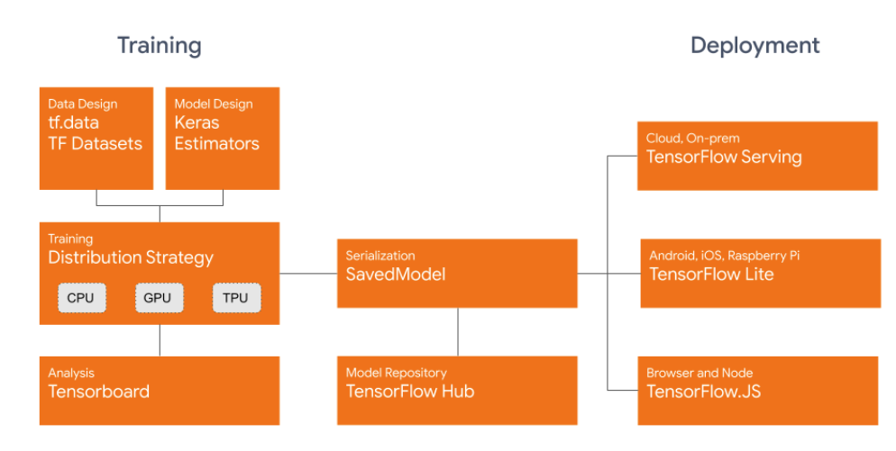
TensorFlow

Slide 37
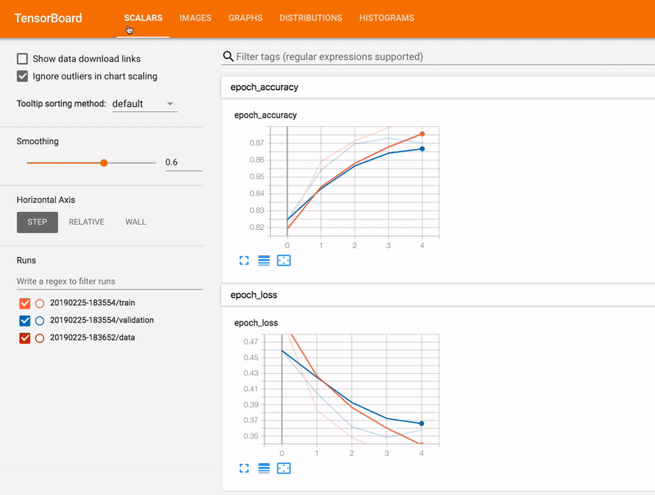
TensorBoard
TensorBoard is a tool for providing the measurements and visualizations needed during the machine learning workflow.
It enables tracking experiment metrics like loss and accuracy, visualizing the model graph, projecting embeddings to a lower dimensional space, and much more.
https://www.tensorflow.org/tensorboard

Slide 38

PyTorch
PyTorch is an open source machine learning library based on the Torch library, used for applications such as computer vision and natural language processing, primarily developed by Facebook's AI Research lab.
It is free and open-source software released under the Modified BSD license.
https://pytorch.org

Slide 39

Keras
Keras is an high level API for Deep Learning Frameworks such as Tensorflow and CNTK.
Keras follows best practices for reducing cognitive load:
it offers consistent & simple APIs,
it minimizes the number of user actions required for common use cases, and
it provides clear & actionable error messages.
It also has extensive documentation and developer guides.
https://keras.io

Slide 40
Keras Model
Models in Keras are defined as a sequence of layers.
Create a Sequential model and add layers one at a time
Ensure the input layer has the right number of input features
Fully connected layers are defined using the Dense class.
Specify the activation function using the activation argument.
Specify the loss function to use to evaluate a set of weights, the optimizer is used to search through different weights for the network
Fit the model
Training occurs over epochs and each epoch is split into batches.
Epoch: One pass through all of the rows in the training dataset.
Batch: One or more samples considered by the model within an epoch before weights are updated.

Slide 41
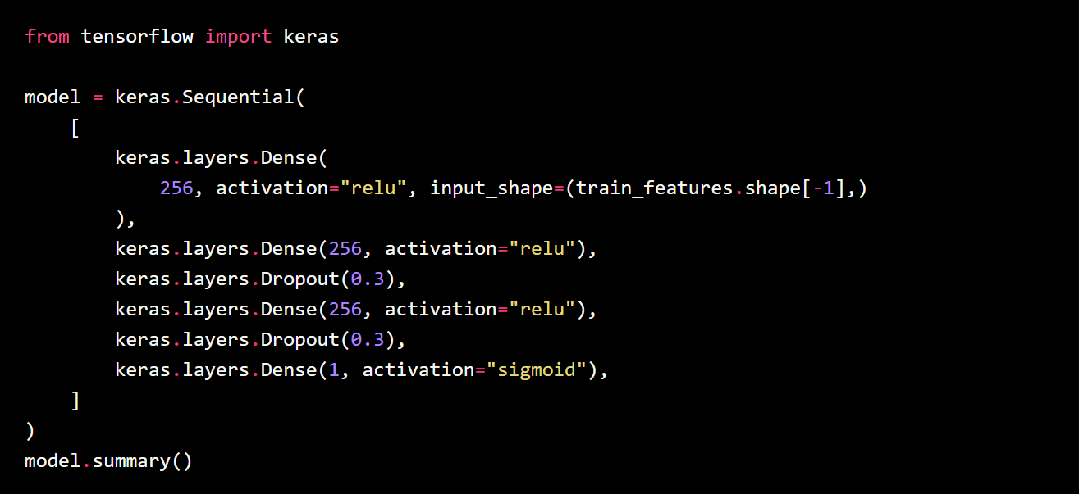

Slide 42
256 nodes
256 nodes
256 nodes
1 node
Input
relu
relu
relu
sigmoid
Output
Hidden Layers

Slide 43
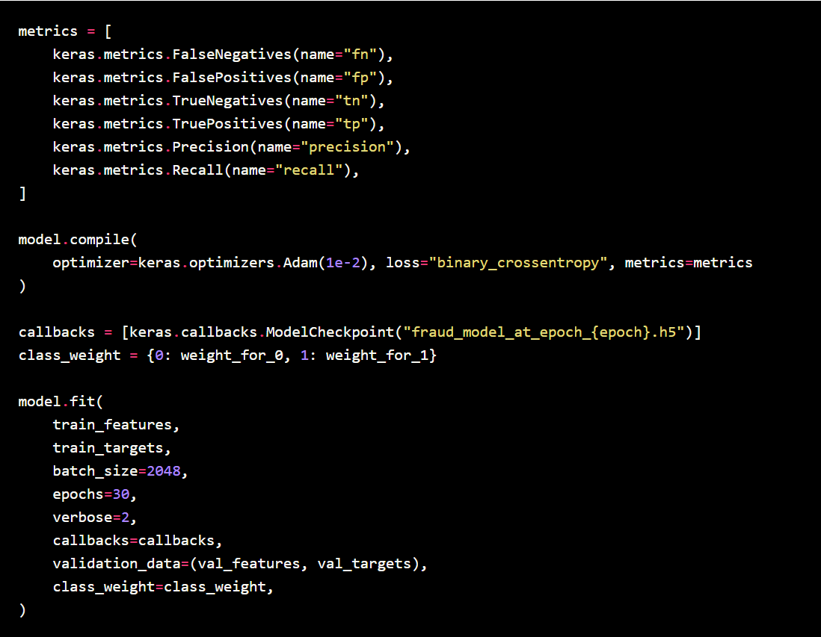

Slide 44
Tips: Number of Hidden Layers
The number of hidden nodes is based on a relationship between:
Number of input and output nodes
Amount of training data available
Complexity of the function that is trying to be learned
The training algorithm
The rule of thumb is to try with maximum 2 hidden layers first before adding more hidden layers

Slide 45
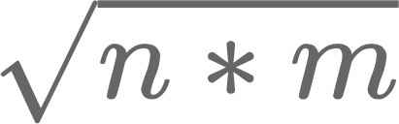
Tips: Number of Nodes
Using too few nodes in the hidden layers will result in something called underfitting.
Using too many nodes will result overfitting and increase the time it takes to train the network
How to choose number of nodes:
The number of nodes should be between the size of the input layer and the size of the output layer.
The number of nodes should be 2/3 the size of the input layer, plus the size of the output layer.
The number of nodes should be less than twice the size of the input layer.
For a three layer network with n input and m output nodes, the hidden layer would have nodes

Slide 46
Tips: Activation Function
How to choose activation function:
If we encounter a case of dead neurons in our networks the leaky ReLU function is the best choice
Always keep in mind that ReLU function should only be used in the hidden layers
As a rule of thumb, you can begin with using ReLU function and then move over to other activation functions in case ReLU doesn’t provide with optimum results

Slide 47
Tips: Activation Function
How to choose activation function:
If we encounter a case of dead neurons in our networks the leaky ReLU function is the best choice
Always keep in mind that ReLU function should only be used in the hidden layers
As a rule of thumb, you can begin with using ReLU function and then move over to other activation functions in case ReLU doesn’t provide with optimum results

Slide 48

Quiz
https://forms.office.com/Pages/ResponsePage.aspx?id=DQSIkWdsW0yxEjajBLZtrQAAAAAAAAAAAAEjV0wuf3JUQUJNRzdQTkpQN1hYTzlGWkhWS0lDVlVaOC4u

Slide 49

https://teachablemachine.withgoogle.com

Slide 50
References
Activation Functions in Neural Networks | by SAGAR SHARMA | Towards Data Science
Various Optimization Algorithms For Training Neural Network | by Sanket Doshi | Towards Data Science

